Slide 1
Quality Assurance of Software and Information Systems Black-box Techniques

Slide 2
Testing Interface To An Application
Web Browser
Presentation Layer
Business Layer
DB Layer
Persistence Layer
Notes:
2

Slide 3
Specification-based or Black-box Techniques
Derive test cases model of what the system should do.
Specifications define what the system should do, not how to do it.
Specification can contain non-functional elements as well as functions.
directly from the specification or from some other kind of
Notes:
What it be easier to define both what and how in the specs? NO

Slide 4
Specification-based Techniques
Equivalence partitioning
Boundary value analysis
Decision table testing
State transition testing
Use case testing

Slide 5
1. Equivalence Partitioning
Inputs to the software or system are divided into groups that are expected to exhibit similar behavior, so they are likely to be processed in the same way.
Equivalence partitions (or classes) can be found for both valid data and invalid data.
Equivalence partitioning can be used to achieve input and output coverage goals.
It can be applied to human input, input via interfaces to a system, or interface parameters in integration testing.
Notes:
Partitions can also be identified for outputs, internal values, time-related values (e.g., before or after an event) and for interface parameters (e.g., integrated components being tested during integration testing). Tests can be designed to cover all valid and invalid partitions.

Slide 6
Data Type Partitioning Examples
Input Condition | Example | Values | # Valid partitions | # Invalid partitions
Range | Age | 1-99 | 1 | 2
Specific Value | Expiration year | 2005 | 1 | 2
Set | Color | Red, green, blue | 1 | 1
Notes:
6
Input condition specifies a range: create one for the valid case and two for the invalid cases.
e.g., for a<=X<=b the classes are
a<=X<=b (valid case)
X<a and X>b (the invalid cases)
Input condition specifies a value: create one for the valid value and two for incorrect values (below and above the valid value).
This may not be possible for certain data types, e.g., for boolean.
Input condition specifies a member of a set: create one for the valid value and one for the invalid (not in the set) value.
e.g., contains(Object o)

Slide 7
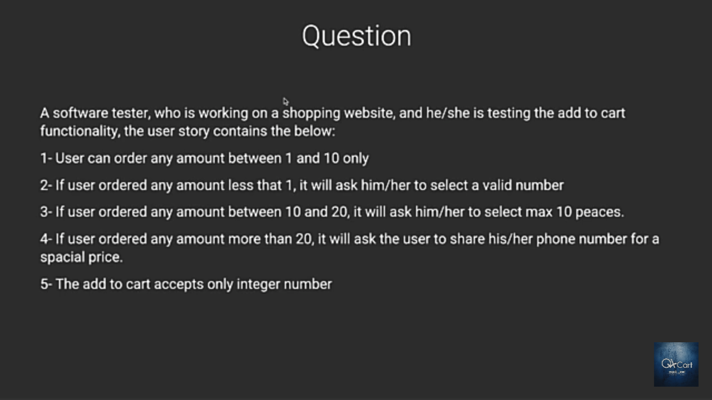
Equivalence Partitioning (Example)

Slide 8
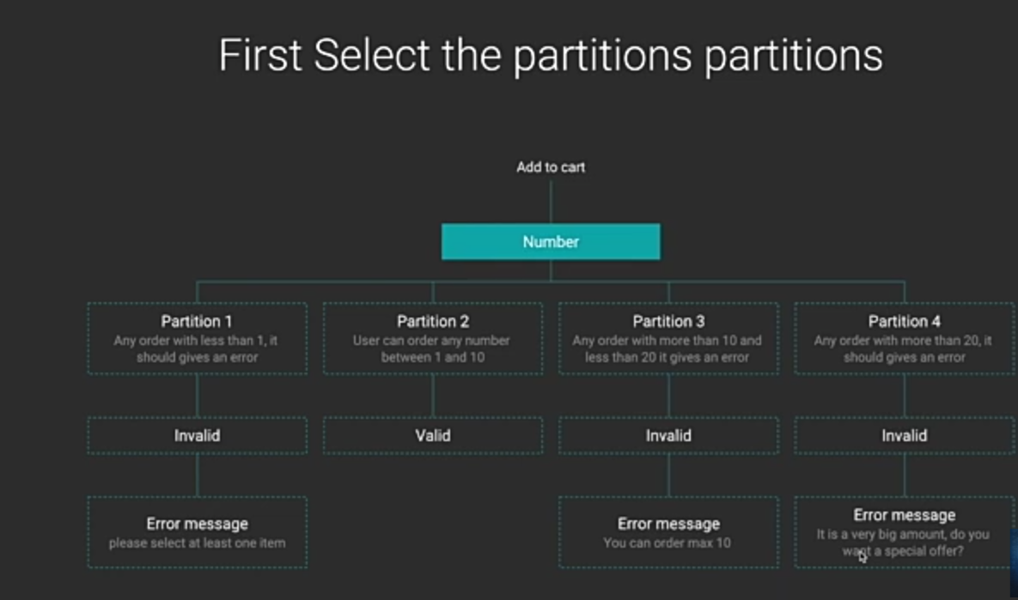
Equivalence Partitioning

Slide 9
2. Boundary Value Analysis (BVA)
A boundary value for a valid partition is a valid boundary value; the boundary of an invalid partition is an invalid boundary value. Tests can be designed to cover both valid and invalid boundary values. When designing test cases, a test for each boundary value is chosen.
Detailed specifications are helpful in determining the interesting boundaries.
This technique is often considered as an extension of equivalence partitioning or other black-box test design techniques.
Boundary Value Analysis has 2 types:
2 Boundary Value Analysis
3 Boundary Value Analysis
Notes:
4.3.2 Boundary Value Analysis (K3)

Slide 10
Boundary Value Analysis(Example)

Slide 11
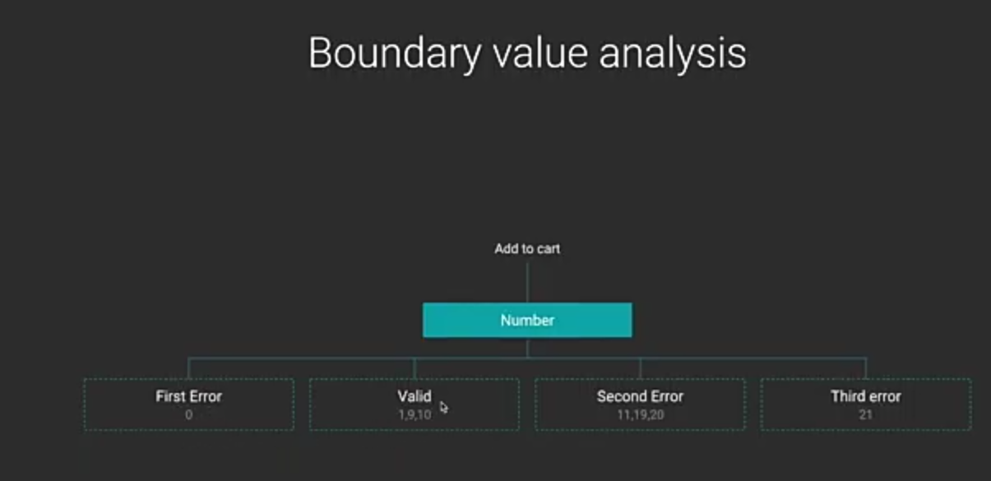
Boundary Value Analysis
2,

Slide 12
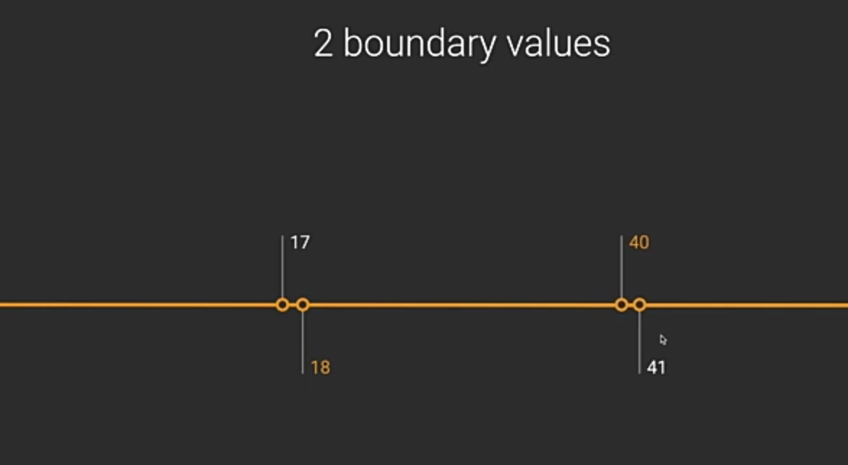
Second Boundary Value Analysis (2BVA)

Slide 13
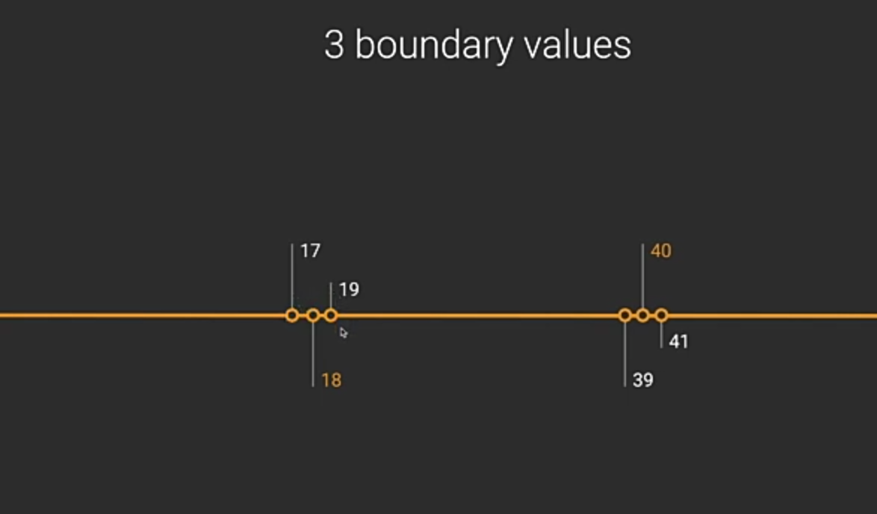
Third Boundary Value Analysis (3BVA)

Slide 14
Test ”Boundaries”
e.g. testing legal inputs (time, in hours):
e.g. testing legal inputs (dates, in April):
Property
Minimum-1
Minimum
Maximum
Maximum+1
Input
-1
0
23
24
Expected output
invalid
Valid
valid
invalid
Actual output
Property
Minimum-1
Minimum
Maximum
Maximum+1
Input
00/4
01/4
30/4
31/4
Expected output
invalid
Valid
valid
invalid
Actual output
Notes:
14

Slide 15
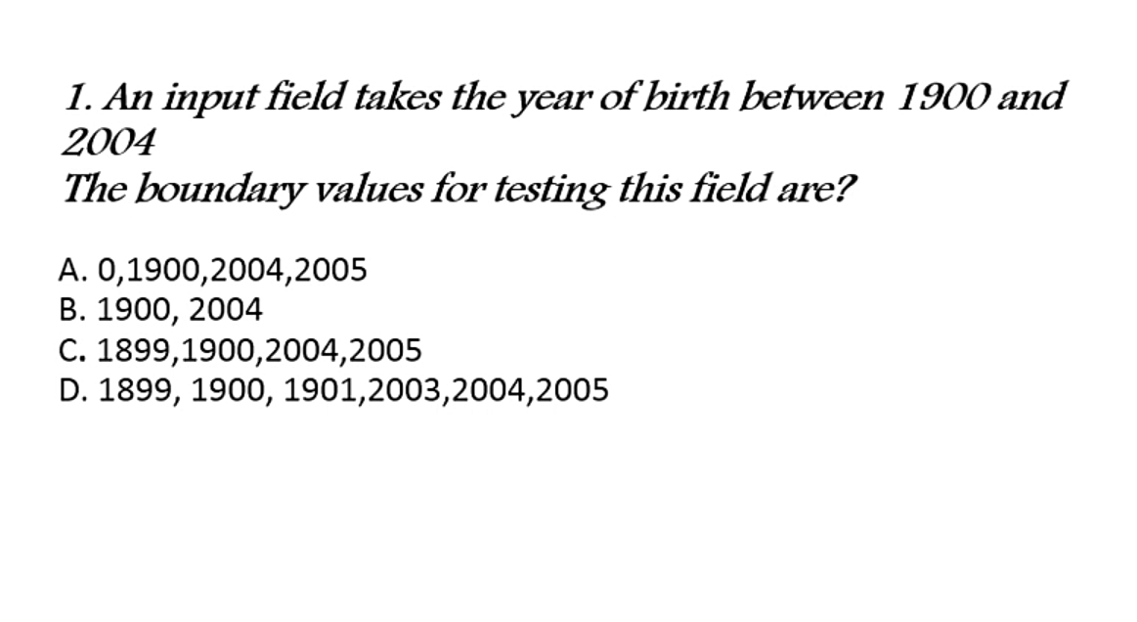
Examples

Slide 16
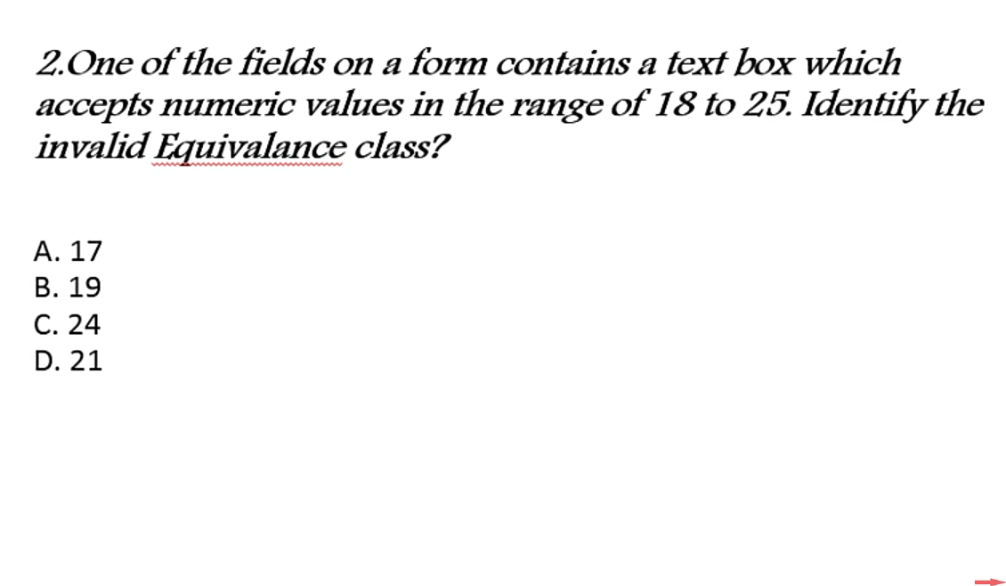
Examples

Slide 17
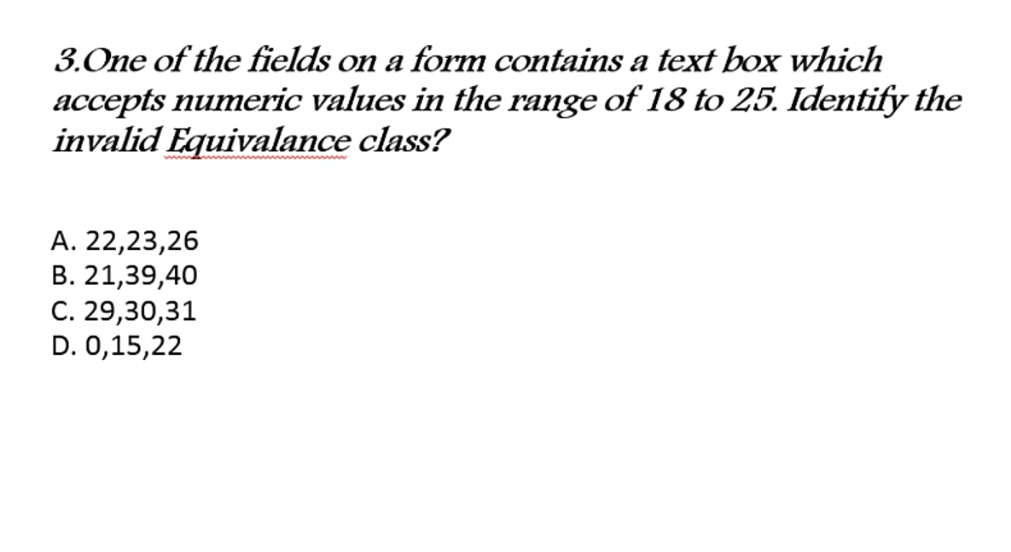
Examples

Slide 18
3. Decision table testing
This approach is for studying the specs carefully and identifying the combinations of input conditions and their effects in a form of a table.
Identify causes (conditions) and effects (actions) in specification
we do not enter every possible combination of conditions into our decision table, but restrict it to those combinations that correspond to business rules – this is called a limited entry decision table to distinguish it from a decision table with all combinations of inputs identified.
Notes:
18
Make Boolean Graph linking causes and effects
Annotate impossible combinations of causes and effects
Develop decision table from graph with a particular combination of inputs and outputs in each column
Transform each column into a test case

Slide 19
3. Decision table testing (cont.)
Decision tables are a good way to capture system requirements that contain logical conditions, and to document internal system design. They may be used to record complex business rules that a system is to implement.
Each column of the table corresponds to a business rule that defines a unique combination of conditions and which result in the execution of the actions associated with that rule.
The coverage standard commonly used with decision table testing is to have at least one test per column in the table, which typically involves covering all combinations of triggering conditions
The strength of decision table testing is that it creates combinations of conditions that otherwise might not have been exercised during testing. It may be applied to all situations when the action of the software depends on several logical decisions.
True- → 1
False → 0
Notes:
No. of test cases=no. of actions + 1
OR
No. of test cases= $2^{n} , where$(n = no. of conditions)

Slide 20
Example - Car Insurance
Requirements for Calculating Car Insurance Premiums:
R1 For females less than 65 years of age, the premium is $500
R2 For males less than 25 years of age, the premium is $3000
R3 For males between 25 and 64 years of age, the premium is $1000
R4 For anyone 65 years of age or more, the premium is $1500
Notes:
20

Slide 21
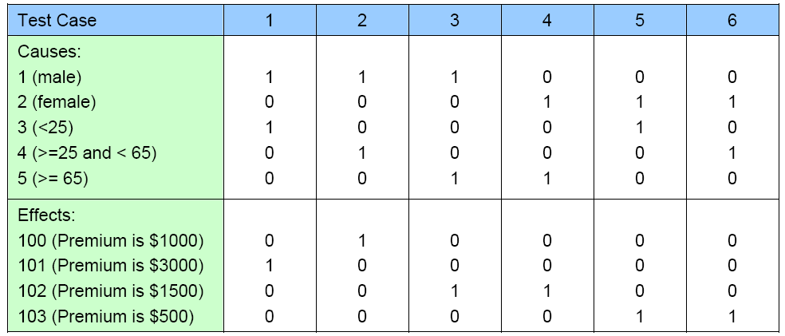
Example - Car Insurance
Methodically trace state conditions in the graphs, converting them into a limited-entry decision table. Each column in the table represents a test case.
Notes:
21

Slide 22
4. State Transition Testing
A system may exhibit a different response depending on current conditions or previous history (its state). In this case, that aspect of the system can be shown with a state transition diagram.
It allows the tester to view the software in terms of its states, transitions between states, the inputs or events that trigger state changes (transitions) and the actions which may result from those transitions.
The states of the system or object under test are separate, identifiable and finite in number.
Tests can be designed to cover a typical sequence of states, to cover every state, to exercise every transition, to exercise specific sequences of transitions or to test invalid transitions.
Notes:
State transition testing is much used within the embedded software industry and technical automation in general. However, the technique is also suitable for modeling a business object having specific states or testing screen-dialogue flows (e.g., for Internet applications or business scenarios).

Slide 23
Example: Reservation System
1- Make a reservation
Provide information including departure and destination cities, dates, and times.
A reservation agent uses that information to make a reservation.
At that point, the Reservation is in the Made state.
The system creates and starts a timer.
If this timer expires before the reservation is paid for, the reservation is cancelled by the system.

Slide 24
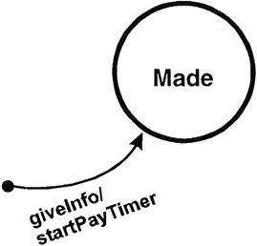
Example: Reservation System
giveInfo, is an event that comes into the system from the outside world.
The command after the "/" denotes an action of the system; in this case startPayTimer.

Slide 25
Example: Reservation System
When money is paid, through initiation of the PayMoney action, the system goes into the “Paid” state.
Events may have parameters associated with them. For example, Pay Money may indicate Cash, Check, Debit Card, or Credit Card
When the ticket is printed, the system goes into the Ticketed State
Upon boarding the plane, the customer gives the boarding pass along with the ticket, which signals that the ticket has been Used.
Anything else after this state?

Slide 26
Example: Reservation System
If the Reservation is not paid on time, the PayTimer expires and the Reservation is cancelled for non-payment.
A reservation may become cancelled if the customer wishes to do so.
This can happen prior to payment or after payment.
If after payment, a refund needs to be generated.
If the customer had the tickets with him, a refund cannot be given unless the printed ticket itself is returned to the agent.
This introduces one new notational element—square brackets that contain a conditional that can be evaluated either True or False.
This conditional acts as a guard allowing the transition only if the condition is true.

Slide 27
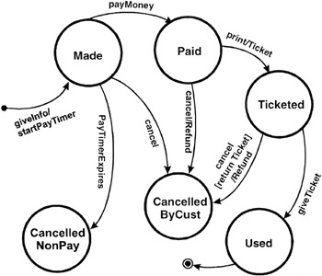
State Transition Diagram of the Reservation System

Slide 28
State-Transition Tables (Cont.)
State-transition tables may be easier to use in a complete and systematic manner.
State-transition tables consist of four columns—Current State, Event, Action, and Next State.
Build the state-transition table as follows
For each state of the system
For each event/trigger of the system
Find the corresponding (Action, Next State) [if any]
Document (state, event, action, next state)

Slide 29
State-Transition Tables (Cont.)
The advantage of a state-transition table is that it lists all possible state-transition combinations, not just the valid ones.
When testing critical, high-risk systems such as avionics or medical devices, testing every state-transition pair may be required, including those that are not valid.
Creating a state-transition table often unearths combinations that were not identified, documented, or dealt with in the requirements. It is highly beneficial to discover these defects before coding begins.

Slide 30
State-Transition Tables (Cont.)
Using a state-transition table can help detect defects in implementation that enable invalid paths from one state to another.
The disadvantage of such tables is that they become very large very quickly as the number of states and events increases.
In addition, the tables are generally sparse; that is, most of the cells are empty.

Slide 31
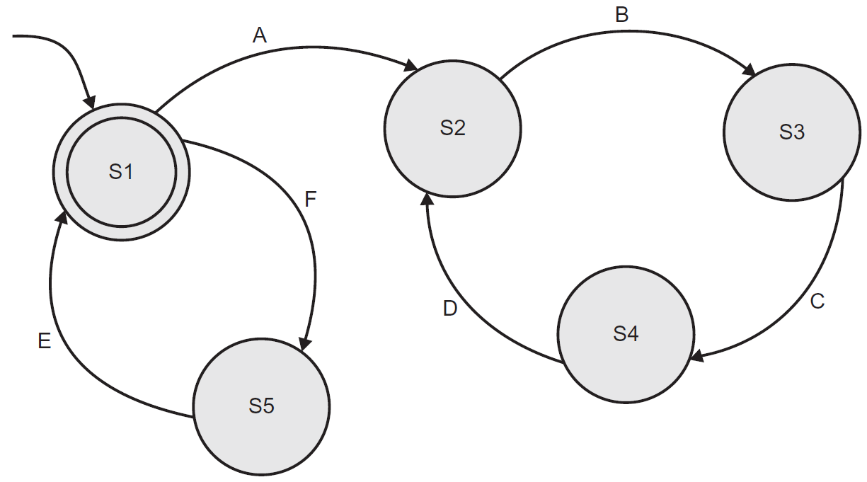
Question
In the state transition diagram in Figure, which of the sequences of transitions below would be valid?
a. ABCDE
b. FEABC
c. ABCEF
d. EFADC
Notes:
b

Slide 32
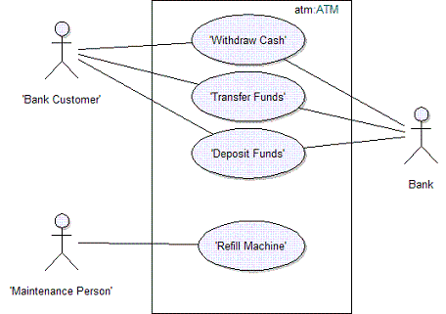
5. Use Case Testing
Use cases describe the “process flows” through a system based on its actual likely use, so the test cases derived from use cases are most useful in uncovering defects in the process flows during real-world use of the system.
Use cases may be described at the abstract level (business use case, technology-free, business process level) or at the system level (system use case on the system functionality level).
Each use case has preconditions which need to be met for a use case to work successfully. Each use case terminates with post conditions which are the observable results and final state of the system after the use case has been completed.
A use case usually has a mainstream (i.e. most likely) scenario and alternative paths.
Notes:
4.3.5 Use Case Testing (K2)

Slide 33
Use Case Testing
Use cases are defined in terms of the actor, not the system, describing what the actor does and what the actor sees rather than what inputs the system expects and what the system‘ outputs.
Use cases are very useful for designing acceptance tests with customer/user participation.
They also help uncover integration defects caused by the interaction and interference of different components, which individual component testing would not see.
Designing test cases from use cases may be combined with other specification-based test techniques

Slide 34
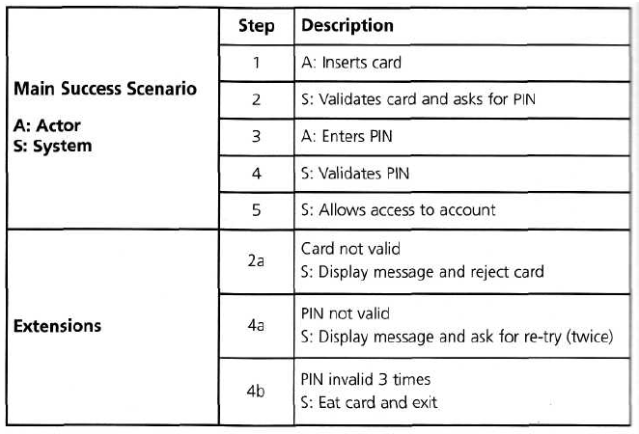
Example
Notes:
Test case for validation card pin

Slide 35
THANK YOU

